Slide 1

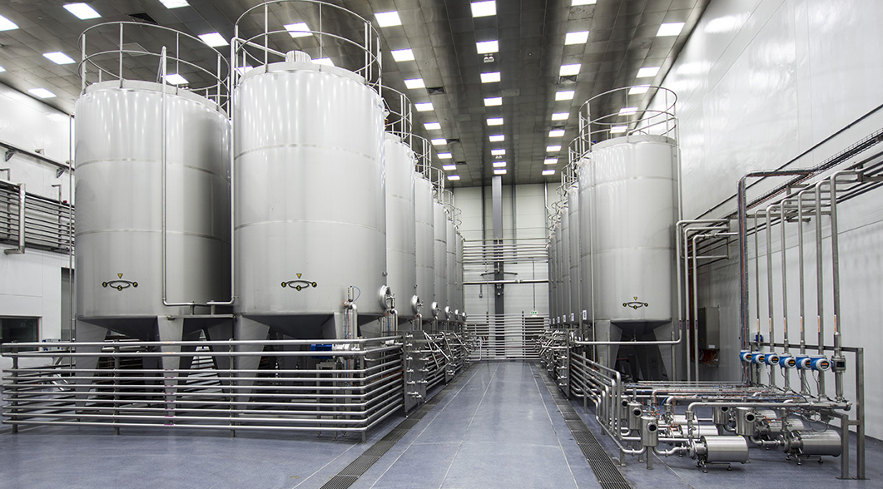

MBH SOLUTIONS SMC-PVT. LTD.
Prepared for the confidential information of:
LAHORE, JAN, 2024

Slide 2
Company Organogram
CEO Mr. Hammad Ashraf
Sales Manager Ms. Nazish Umar
Admin Manager Mr. Bilal
Finance Consultant Mr. Faisal
Technical Manager Hammad Ashraf
Quality Consultant Mr. Atif
Sales Coordinator Mr. Ali Imran
Workshop Supervisor M. Naeem
Electrical Engineering and Automation M. Faraz M. Usama
Production & Assembly
Installation and Start-up
Maintenance
Customer Service M. Usama M. Khurram
After Sales Support
Logistic and Transport Mr. Khubaib
Piping and Erection Mr. Adeel Aslam

Slide 3
MBH SOLUTIONS Range of Solutions
Turnkey customized Solutions for CSD and Juice Process Systems
Design and Consultancy for Sugar Dissolving, Syrup Room and CIP Systems
Screw conveyor for bulk material handling
Tanks, Vessels, Piping, Structure design and fabrication for Stainless Steel and Mild Steel, Carbon Steel
Product Recovery Solution ( Pigging System )

Slide 4
MBH SOLUTIONS Range of Products
Flow Components ( Pumps, Valves, Strainers, Spray Balls )
Automation Products ( PLC, HMI, SCADA, VFD/INVERTER )
Instruments ( Temperature, Pressure, Flow Meters, Conductivity and Proximity Sensors)
Low Voltage Switchgears & Electrical Components (Breaker, Contactor, Motors, Accessories & Control Panel)

Slide 5
MBH SOLUTIONS Range of Products
LAB Equipment's – PET and Packaging testing equipment
Online Analyzers for CO2 and Brix Monitoring System
Dosing and Metering Pumps ( Fruit Juice, Pulp, Ketchup, Cosmetic and Shampoo )
Labelling Machines and complete solutions for Labelling
Hazardous and Toxic Gas Monitoring System (e.g. NH3, CO, LPG, CH4 etc.)

Slide 6
MBH SOLUTIONS Range of services
Services for CIP, Juice and CSD Process Systems optimization
Mechanical and Electrical Installation
End to End design of Electrical Plan for complete Factory
Spare Parts, Services & Maintenance Contracts for Sugar dissolving and Syrup room
Automation Solutions & Services for entire production processes and systems

Slide 7
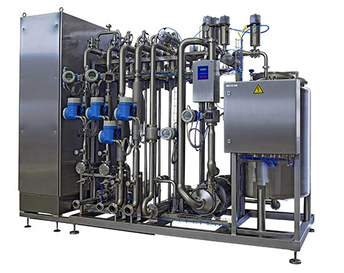
5. Company MBH Process Capabilities
General Description
Customizes modules / projects to the requirements of each individual customer
Focus of business is syrup rooms
Types of projects: Green field, brown field, expansion & up-grade
Process / Product Matrix
Storage & Distribution of Sugar
Deaeration
Storage Dissolving
Sugar Syrup Treatment
Mixer, Blender, Carbonation
Final Beverage Blending & Processing
Distribution & Piping
Sugar Syrup Storage
Control & Automation
Concentrates, Flavors & Powder Handling
Mixing Tanks
CIP-Cleaning
Product Group
Active Carbon Filtration
Customer Process
(exemplary)
Carbonated Soft Drinks
✓
✓
✓
✓
✓
✓
✓
✓
✓
✓
✓
Juice Hot-Filling
✓
✓
✓
✓
✓
✓
✓
✓
✓
✓
Water Treatment CSD, Juice, Tea
✓
✓
✓
✓
✓
Water Treatment Table Water
✓
✓
✓
✓
✓
✓
Water Treatment Mineral Water
✓
✓
✓
✓
✓

Slide 8





OUR PARTNERS
SSP GmbH - Germany
Flow Components Division
www.mbhsol.com www.ssp-gmbh.com hammad@mbhsol.com +92 332 200 7373

Slide 9











BRANDS WE DEAL IN
www.mbhsol.com www.ssp-gmbh.com hammad@mbhsol.com +92 332 200 7373

Slide 10
Our References
Erection and Commissioning of Syrup Room, CIP system at Coca Cola Tehran, Iran
Startup and Commissioning of Sugar Dissolving, pasteurizer, Concentrate Station System at Coca Cola Isparta, Turkey
Integration and upgradation of Syrup Room, CIP System with SIDEL Line at Pepsi Northern Beverages
Sugar Dissolving Syrup Room Upgradation for Pepsi Cola Haidri Beverages at VDM System
Screw Conveyors Manufacturing for Pepsi Cola Haidri Beverages
Electrical and Automation Panel Design, Supply and Programming for Cream Mixing System at Fauji Foods
Electrical and Automation Panel Design, Supply, Programming and SCADA development for Recombined Milk System at Dalda Foods (In progress)
Erection of Machinery at Haidri Beverage
Tanks and Equipment maintenance and Polishing for Pepsi Cola Naubahar Beverages
Maintenance of 25,000 LPH Pasteurizer at Pepsi Cola Northern Beverages
Maintenance of Filtration System Della Toffola NF 30 at Pepsi Cola Northern Beverages
Maintenance of Filtration System Della Toffola at Master Beverages
Structure, Tanks, Cabinets Manufacturing at workshop for various clients
www.mbhsol.com www.ssp-gmbh.com hammad@mbhsol.com +92 332 200 7373

Slide 11

CONTACT DETAILS
CONTACT DETAILS :- Email: hammad@mbhsol.com
Phone: +92 332 200 7373
Website: www.mbhsol.com
Address: 1st Floor , 37 MB, Commercial Area, MECHS, College Road, Lahore, Pakistan
MBH SOLUTIONS SMC-PVT. LTD.

